Slide 1


Non-negative Matrix Factorization and The Fascicles of Emily Dickinson
(or, NMF, for short)
A talk by
Jonathan Armoza

Slide 2
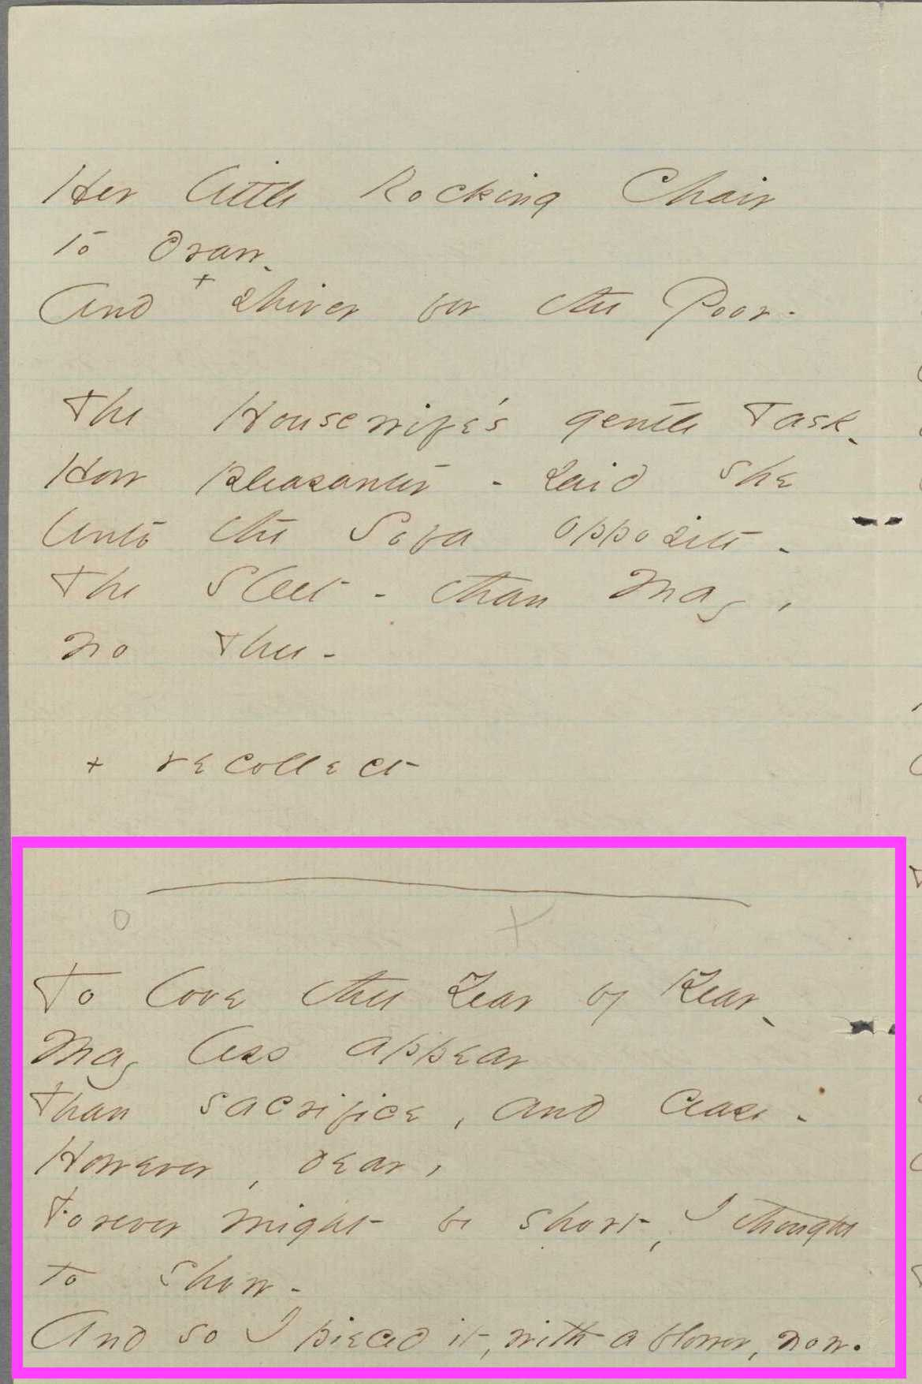
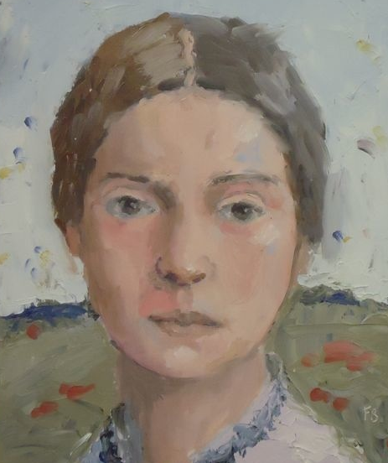
Emily Dickinson’s Fascicles
From Fascicle 29:
(1) part of The Night was wide, and furnished scant
(2) To love thee Year by Year -
b. 1830, d. 1886
authored ~1800 “poems”
copied & sewed 811 of them into 40 manuscript books
others were stacked in 15 sets
Images c/o fredbellpaintings.com, 2013 and the Emily Dickinson Archive, 2013

Slide 3
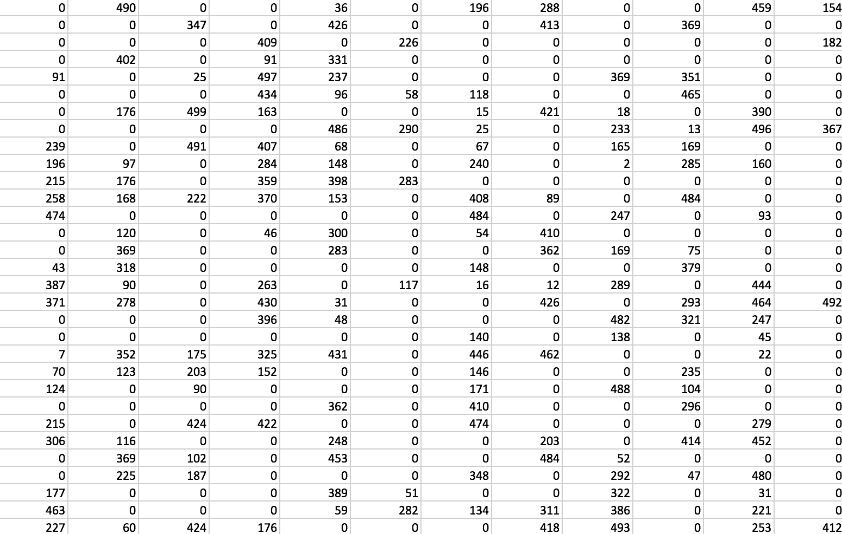
So, you have a lot of data... Some of it sparse

Slide 4
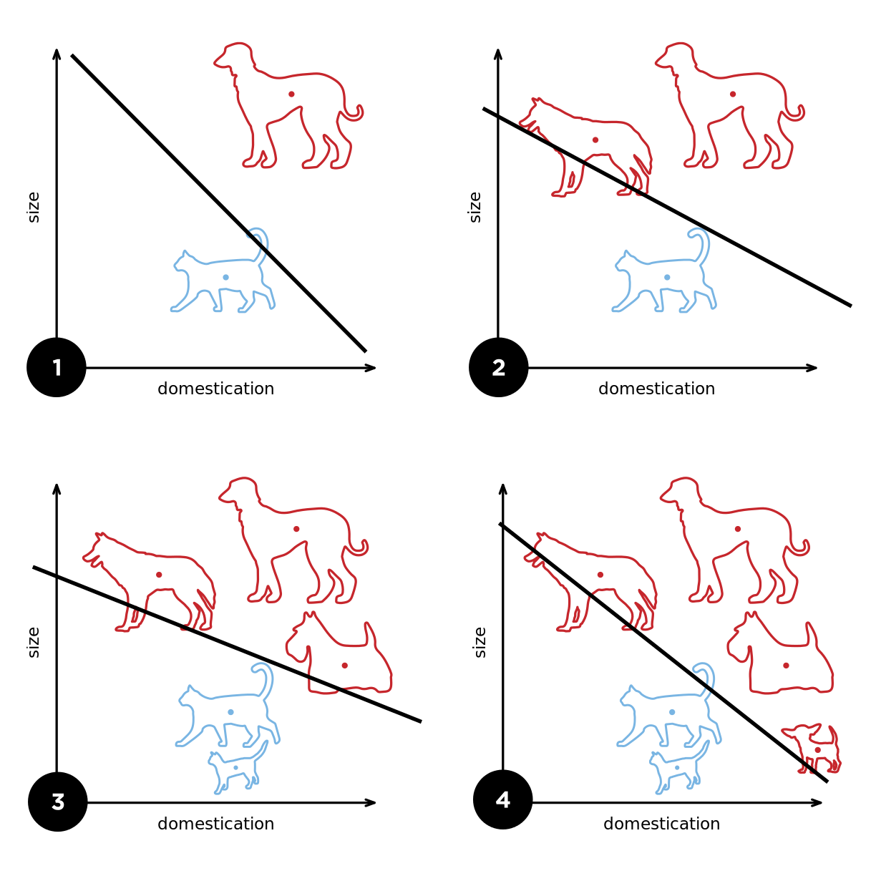
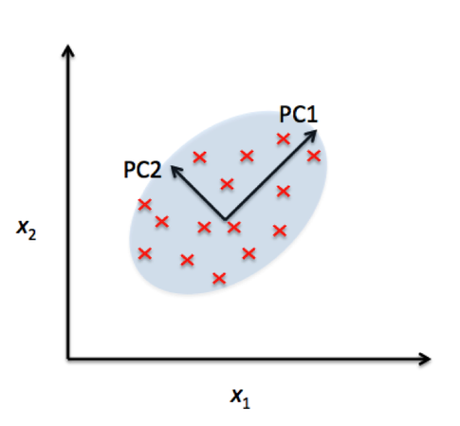
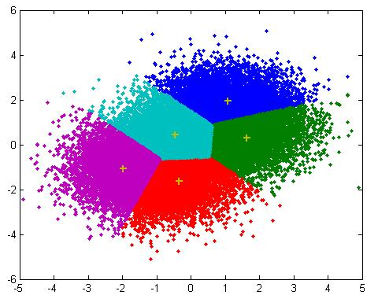
Things We’re Used To Doing
Dimension Reduction
(e.g. PCA)
Clustering
(e.g. K-means)
Machine Learning
(e.g. supervised and
unsupervised models)
Images c/o sebastianraschka.com 2013, Yi Cao@mathworks.com 2008, and Elizabeth Godspeed @wikipedia.org

Slide 5
Words and Vectors and Matrices
Nouns, Verbs
=
=
Emily wrote 1800 poems.
[ 1 1 ]
a + b
=
=
1 1
2 2
Emily wrote 1800 poems.
She sewed 40 fascicles and left 15 sets.
a + b,
2a + 2b
Can enable us to understand shared statistical qualities of these values, e.g. average, variance

Slide 6
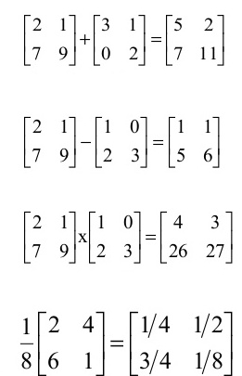
Matrix Math and the Qualities of our Data
addition
subtraction
matrix multiplication
25
scalar multiplication

Slide 7
Matrix Math and the Qualities of our Data
addition
subtraction
matrix multiplication
25
scalar multiplication

Slide 8
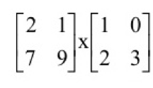

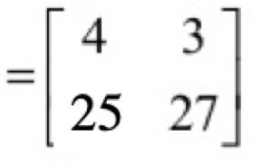
Matrix Multiplication & Linear Combinations
(2 x 1) + (1 x 2) (2 x 0) + (1 x 3)
(7 x 1) + (9 x 2) (7 x 0) + (9 x 3)
=
4a + 3b and 25a + 27b

Slide 9
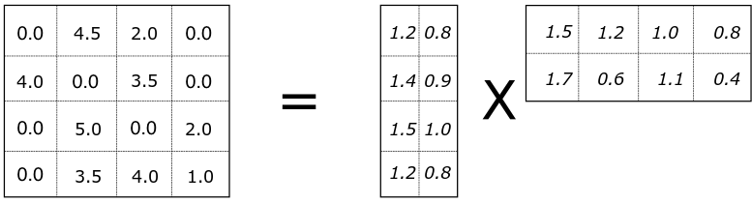
Matrix Math and the Latent Features in our Data
our data: V
potential factors: W and H
m
n
n
r
m
r
r factorization rank
(n + m)r < nm
n records
m features

Slide 10
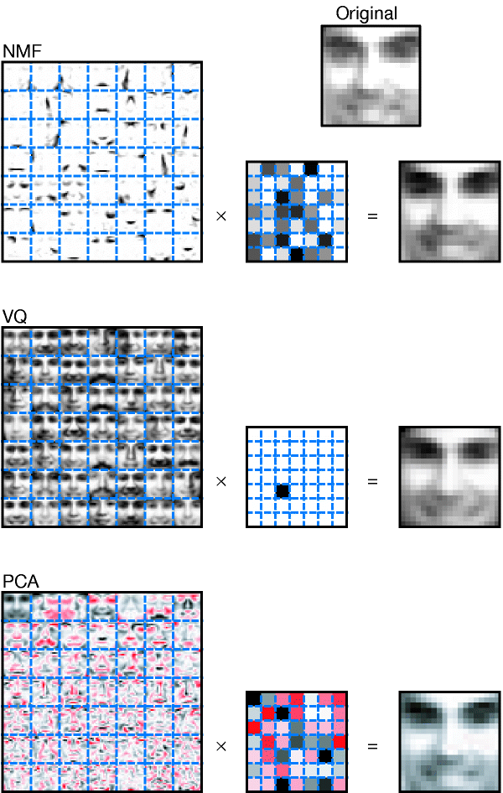
Vector Quantization (VQ) – Comprehensive
Constraints on W and H:
Each column of H is a unary vector
Every face (column of V) is approximated by a single basis image (column of W)
W
H
Linear
Combination
Image c/o Lee and Seung, 1999

Slide 11
Principle Components Analysis (PCA) – Comprehensive, More Accurate, Less Intuitive
Constraints on W and H:
Linear combinations of W and H are orthogonal and orthonormal
W
H
Linear
Combination
Images c/o Lee and Seung, 1999

Slide 12
Non-negative Matrix Factorization – Feature-based and Composite (Lee & Seung, 1999)
Constraints on W and H:
All values of W and H are positive
Multiple basis images act as parts to constitute a whole
W
H
Linear
Combination
Images c/o Lee and Seung, 1999

Slide 13
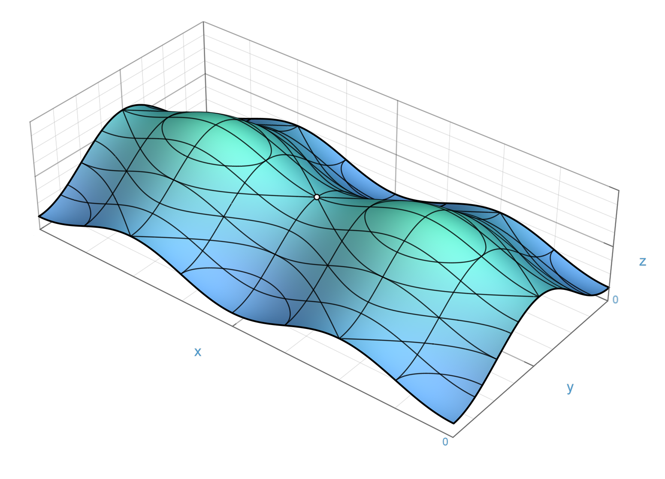
What does NMF give us?
It turns out that the notion of composition intuitively set by a constraint of positive factor matrix coefficients results in a lot of ‘holes’ in both the basis and encoding matrices.
Image c/o Wikimedia Commons 2016

Slide 14
What does NMF give us?
A ground-level based topology of prominent and basic features of a individual datum that more realistically reflect our data’s attributes
Intuitive results that can produce prototypical representations of hidden categories of records in a data set
And, in turn, intuitive interpretations of high dimensional data, particularly helpful if it is sparsely populated to begin with

Slide 15
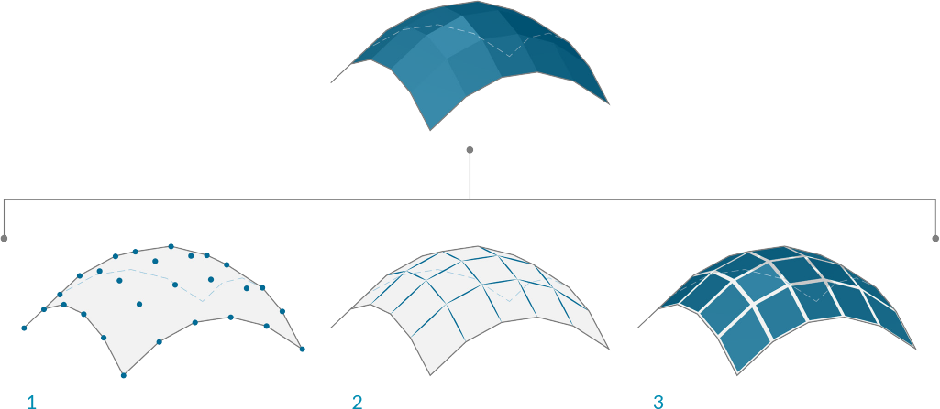
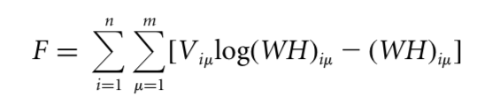
NMF Learns the Approximate Probability Distribution that ‘created our’ data
probability distribution
our data
Mesh image c/o Modelab 2015

Slide 16
Probabilistic Models like Topic Models
Trying to understand many variables that interact in a high dimensional space
Encourage us to think of humanities data in new – and sometimes counterintuitive – ways
For instance, we'd like to develop an understanding of the joint probability distributions that could have generated our data set

Slide 17
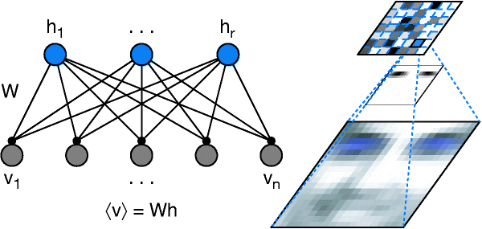
Factorization Rank and Hidden Factors
(n + m)r < nm
Entries in encoding matrix H can be considered to represent
hidden factors that went into the production of our data V

Slide 18
Netflix and Recommender Systems
$1,000,000 Contest in 2006
Goal: Beat Netflix’s user rating accuracy
Winning Solution by Koren, Bell, and Volinsky (2009):
Based on:
Custom-tailored, Bayesian probabilistic version of NMF
Developed by University of Toronto researchers, Mnih and Salakhutdinov (2008)

Slide 19
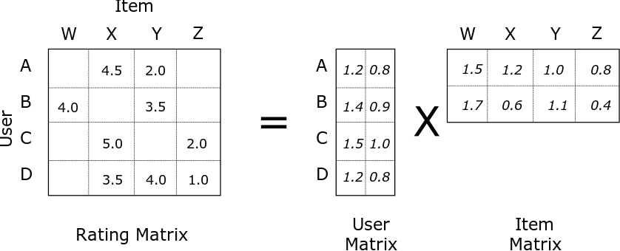
Netflix and Recommender Systems
Factor matrices represent basis and hidden (or encoded) factors.
In the case of Netflix, basis user and hidden movie factors.
Image c/o data-artisans.com 2015

Slide 20
Nimfa (nimfa.biolab.si)
A Python library for Nonnegative Matrix Factorization, Nimfa, was originally designed for biological studies (e.g. genetics)
It includes:
Several factorization methods/models
Support for dense and sparse matrices
Internally stores fitted models across iterations/runs
Several matrix initialization options
Connectivity/consensus and scoring methods

Slide 21
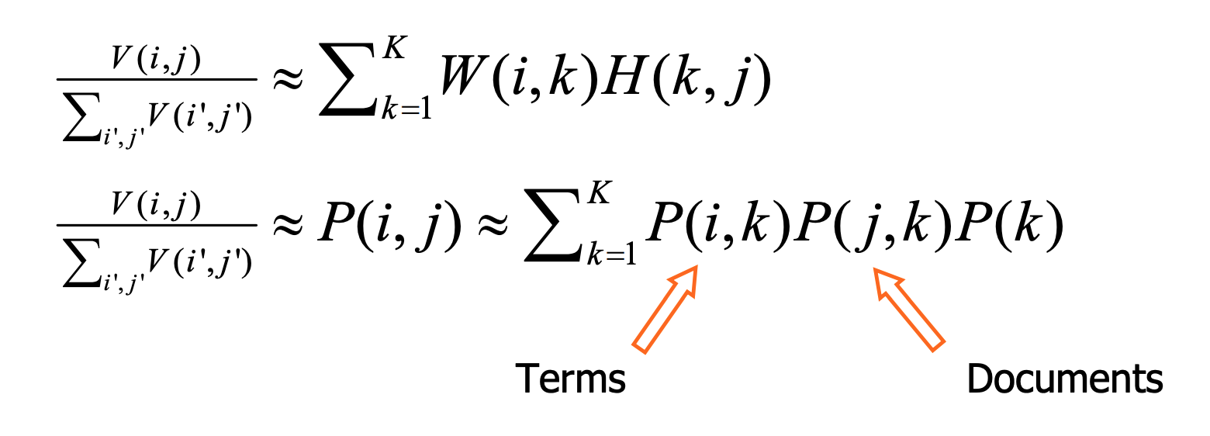
Probabilistic Matrix Factorization (PMF)
NMF but as a multinomial mixture model
Treats V as a matrix of ‘counts’
* matrix entries i, j
factorization iterations k

Slide 22
Probabilistic Matrix Factorization (PMF)
Goal: Determine the most probable factor matrices that represent the hidden factors of the records and features of our matrix.
What else could we do with this method? Run it on our quantitative and qualitative humanities data sets.
Like POS counts.

Slide 23
Words and Vectors and Matrices
Nouns, Verbs
=
=
Emily wrote 1800 poems.
[ 1 1 ]
a + b
=
=
1 1
2 2
Emily wrote 1800 poems.
She sewed 40 fascicles and left 15 sets.
a + b,
2a + 2b

Slide 24
PMF on Emily Dickinson’s Parts of Speech (POS)
(1) Tag POS of texts/text segments through spaCy (spacy.io)
(2) Count (and normalize) words of 16 POS categories (incl. untaggable) so each poem becomes a vector, and all poems together become a matrix
(3) Run Nimfa’s PMF on the poem matrix (nimfa.biolab.si)
(4) Examine Results and Revise by experimenting with factorization rank, number of model iterations, program runs, and initializations
(5) Cluster poems by hidden POS patterns

Slide 25
A Quick Exploration of a PMF Model based on Parts of Speech
Thinking of Clusters as Centroids
(1) Calculate average POS profile vector of each cluster as the center of a centroid
(2) Calculate the variance of each poem’s POS vector (normalized) from that average POS profile vector

Slide 26
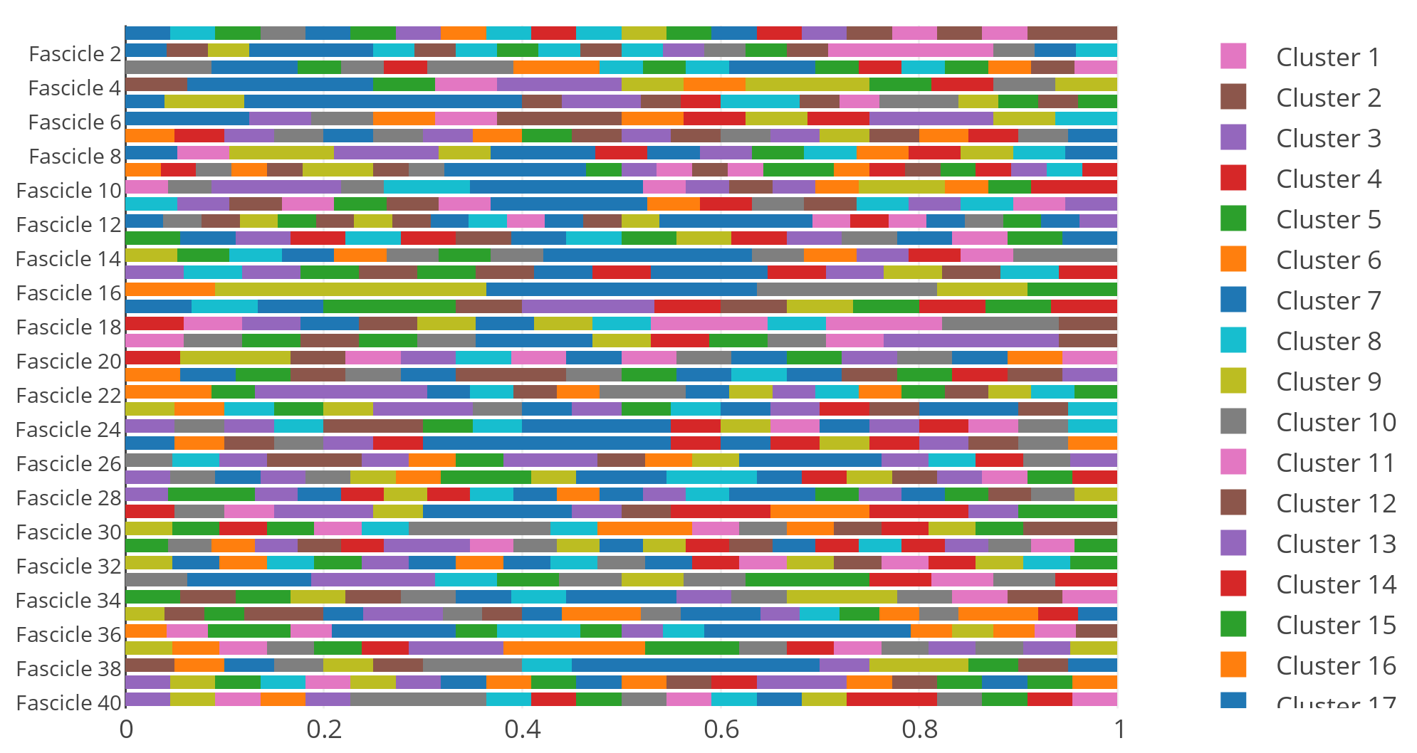
(247) PMF Profiles at Macroanalytic Scales

Slide 27
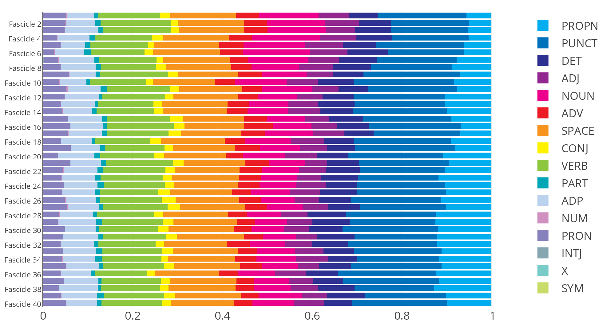
Proportional Representation of PMF Profiles

Slide 28
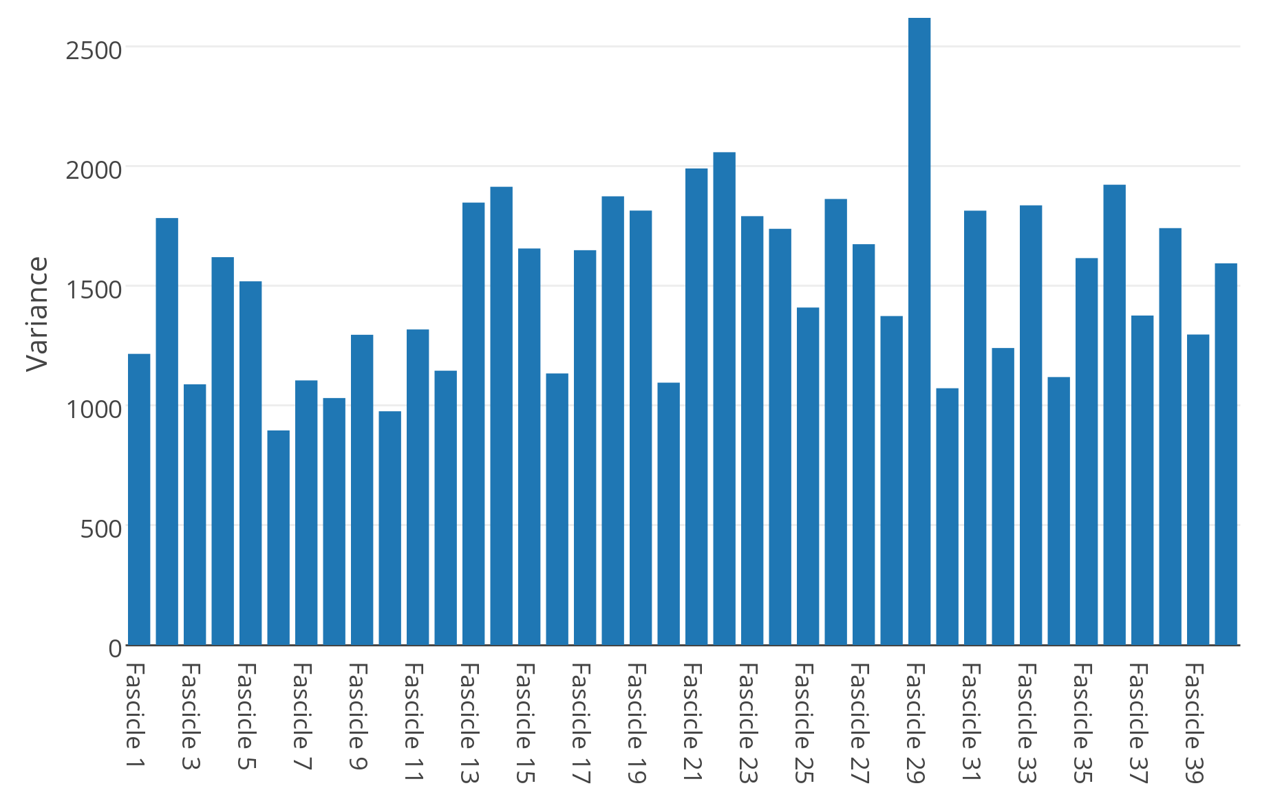
How much do poem profiles vary from the PMF Profile of the overall manuscript?
What??

Slide 29
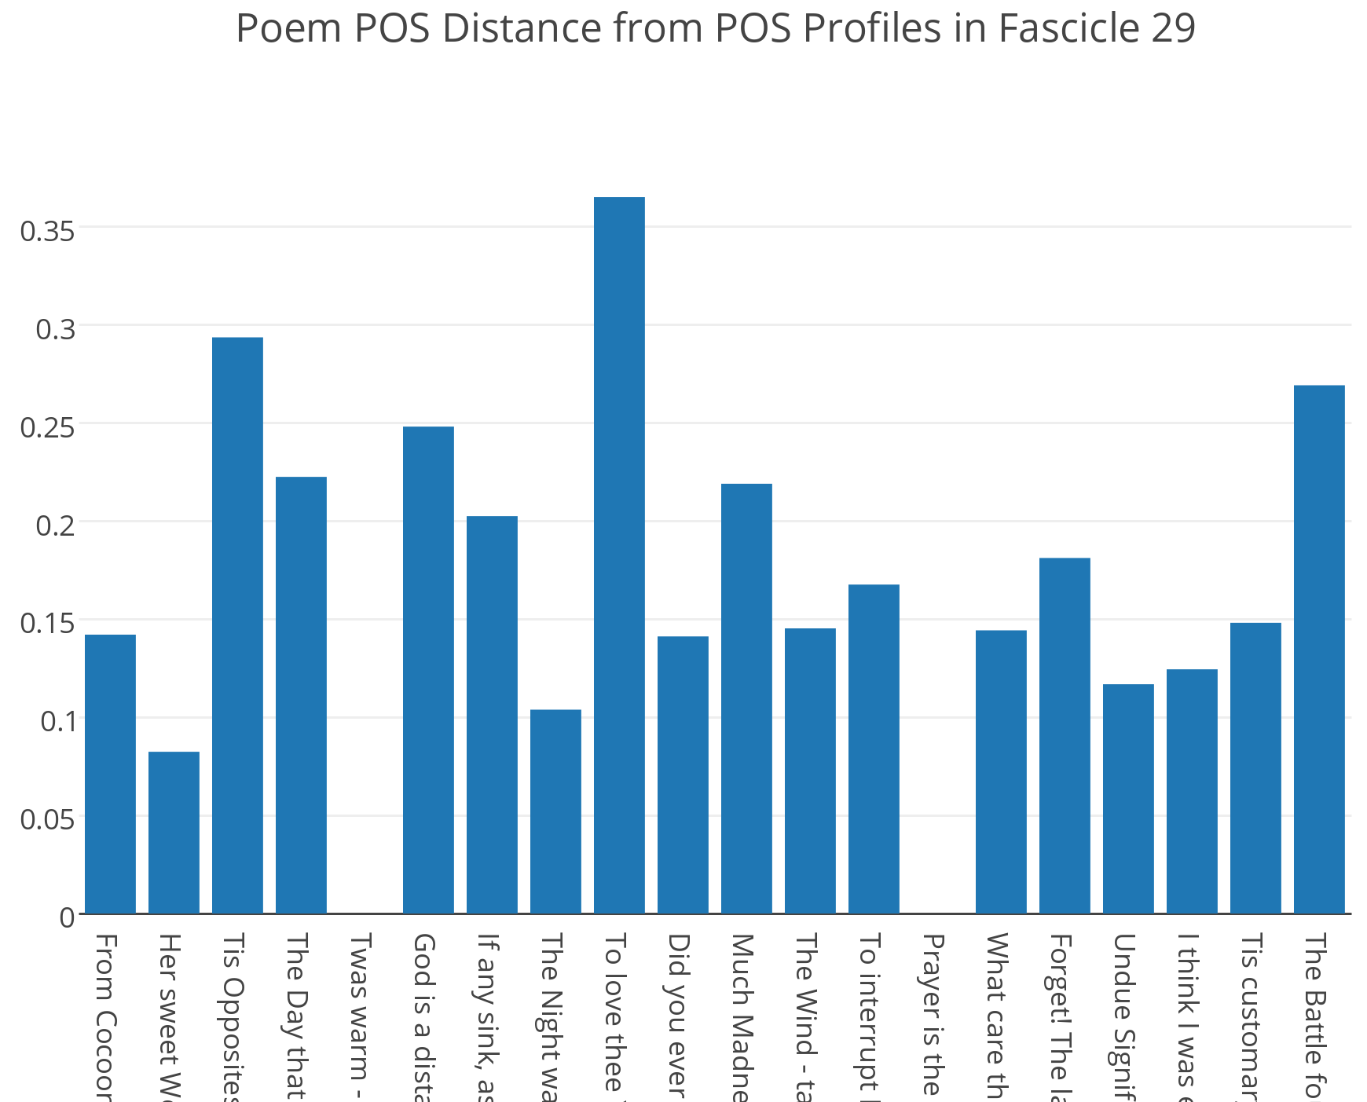
The Wildly Varying 29th Fascicle
Hmm...

Slide 30
To love thee Year by Year — May less appear Than sacrifice, and cease — However, dear, Forever might be short, I thought to show — And so I pieced it, with a flower, now.
9th poem of Emily Dickinson’s 29th fascicle

Slide 31
PMF Cluster 55
Poem 9 of Fascicle 29: To love thee Year by Year PMF Part of Speech Cluster 55 Similar Poems: Poem 19 of Fascicle 1: "Oh if remembering were forgetting -” Poem 7 of Fascicle 2: "It did not surprise me” Poem 23 of Fascicle 3: "If I should die” Poem 1 of Fascicle 4: "Perhaps you'd like to buy a flower” Poem 13 of Fascicle 9: "I shall know why - when Time is over” Poem 27 of Fascicle 9: "I should not dare to leave my friend” Poem 8 of Fascicle 12: "I got so I could hear his name” Poem 5 of Fascicle 16: "I felt a Funeral, in my Brain” Poem 16 of Fascicle 19: "I cried at Pity - not at Pain” Poem 1 of Fascicle 21: "I Years had been from Home” Poem 18 of Fascicle 22: "I was the slightest in the House” Poem 8 of Fascicle 28: "The Winters are so short” Poem 10 of Fascicle 29: "Did you ever stand in a Cavern's Mouth” Poem 11 of Fascicle 38: "I play at Riches - to appease"

Slide 32
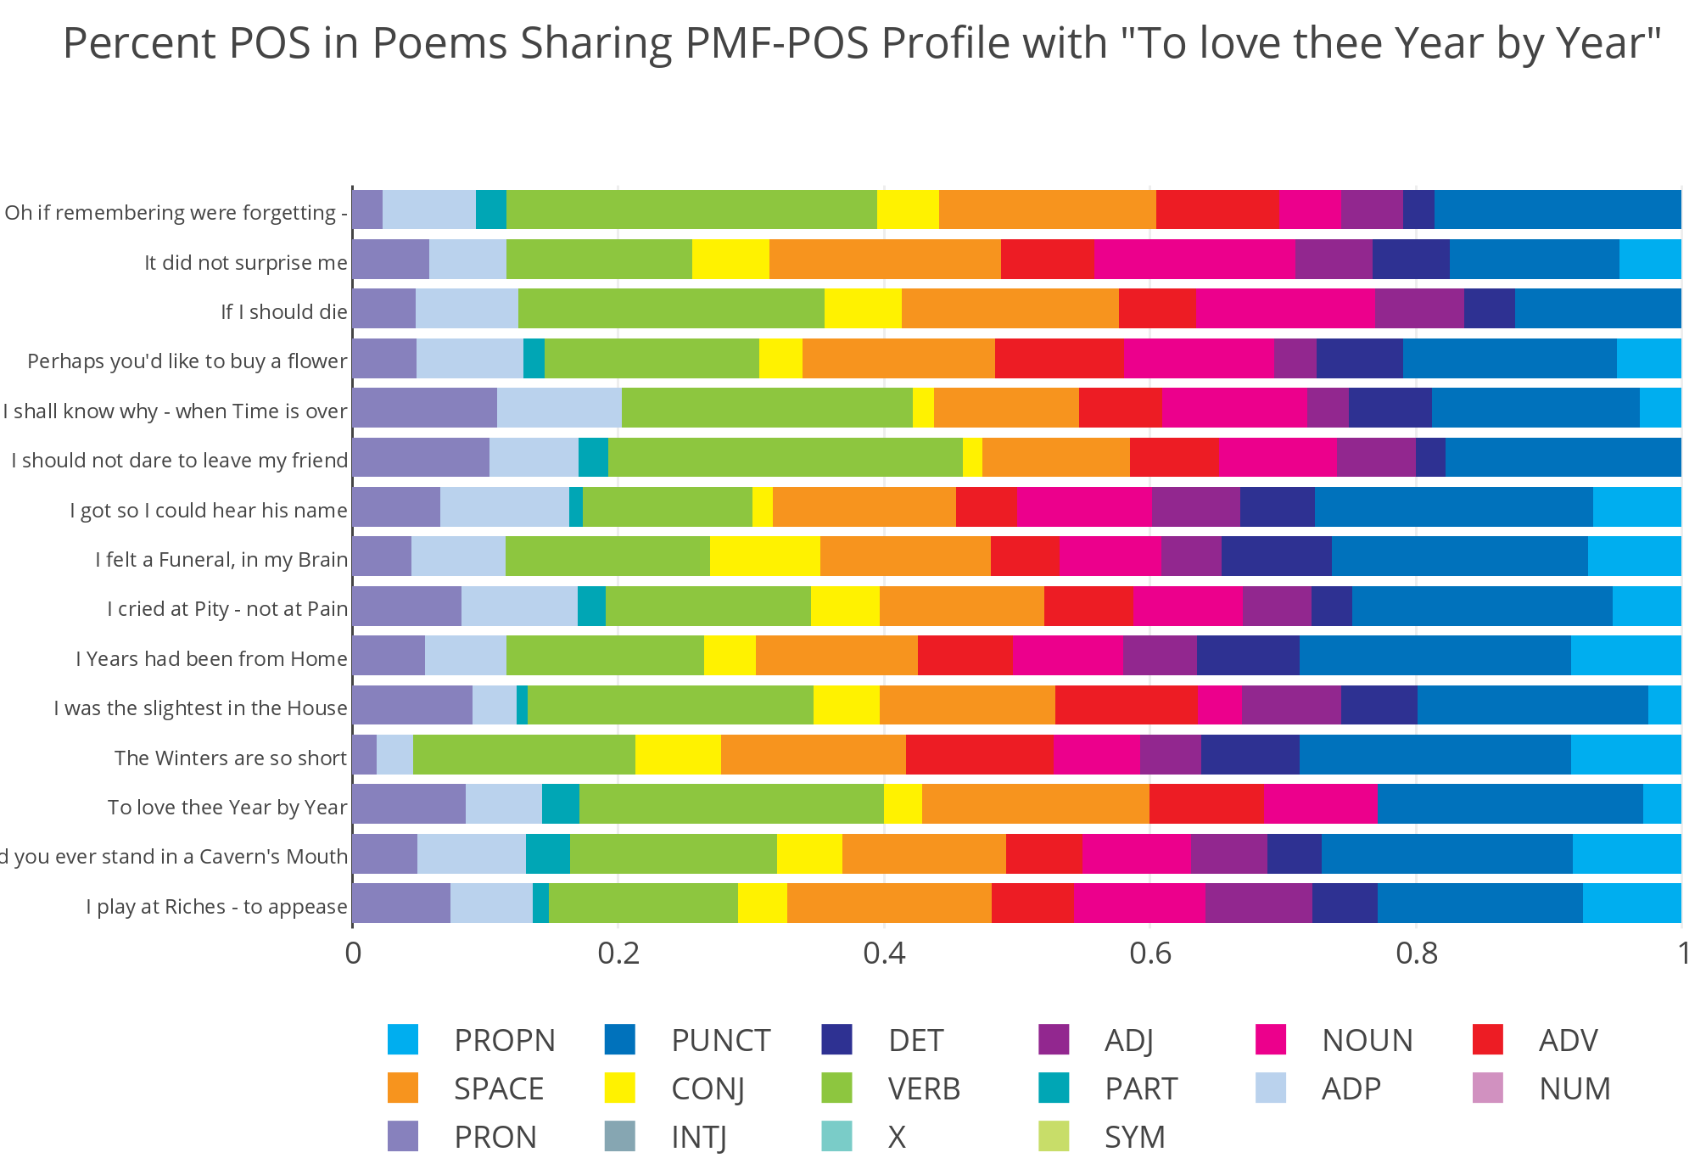
A Look Inside PMF Cluster 55

Slide 33
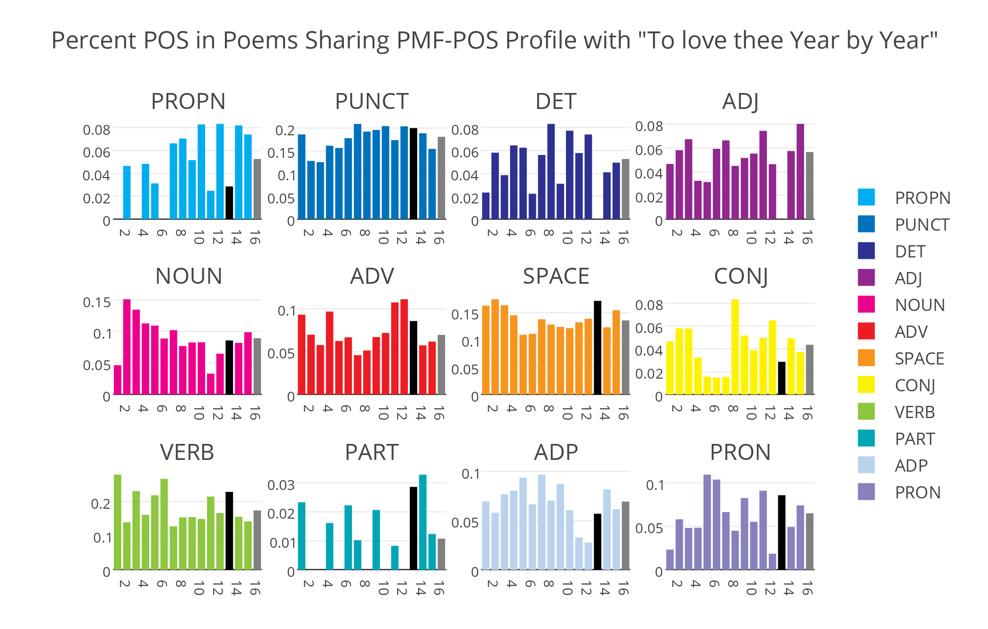
Comparing Hidden Factors to Visible Ones

Slide 34
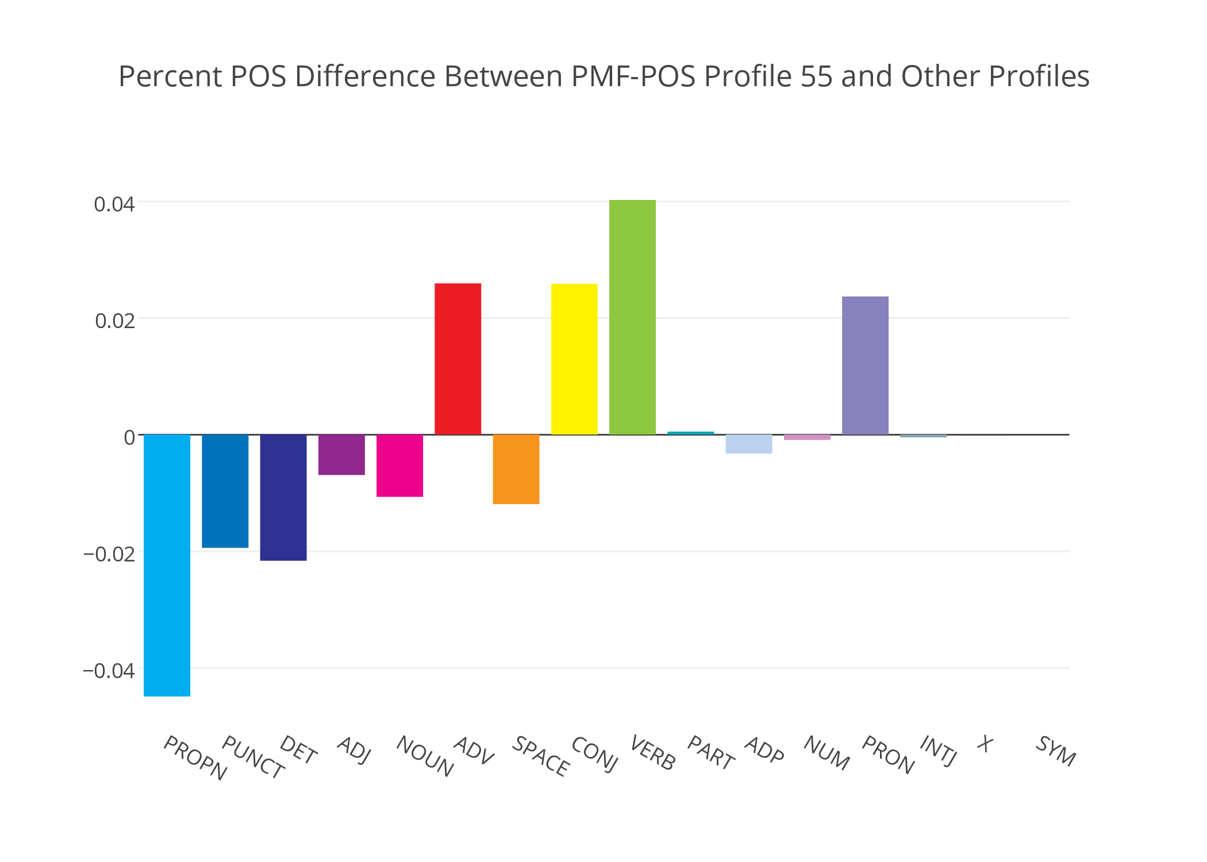
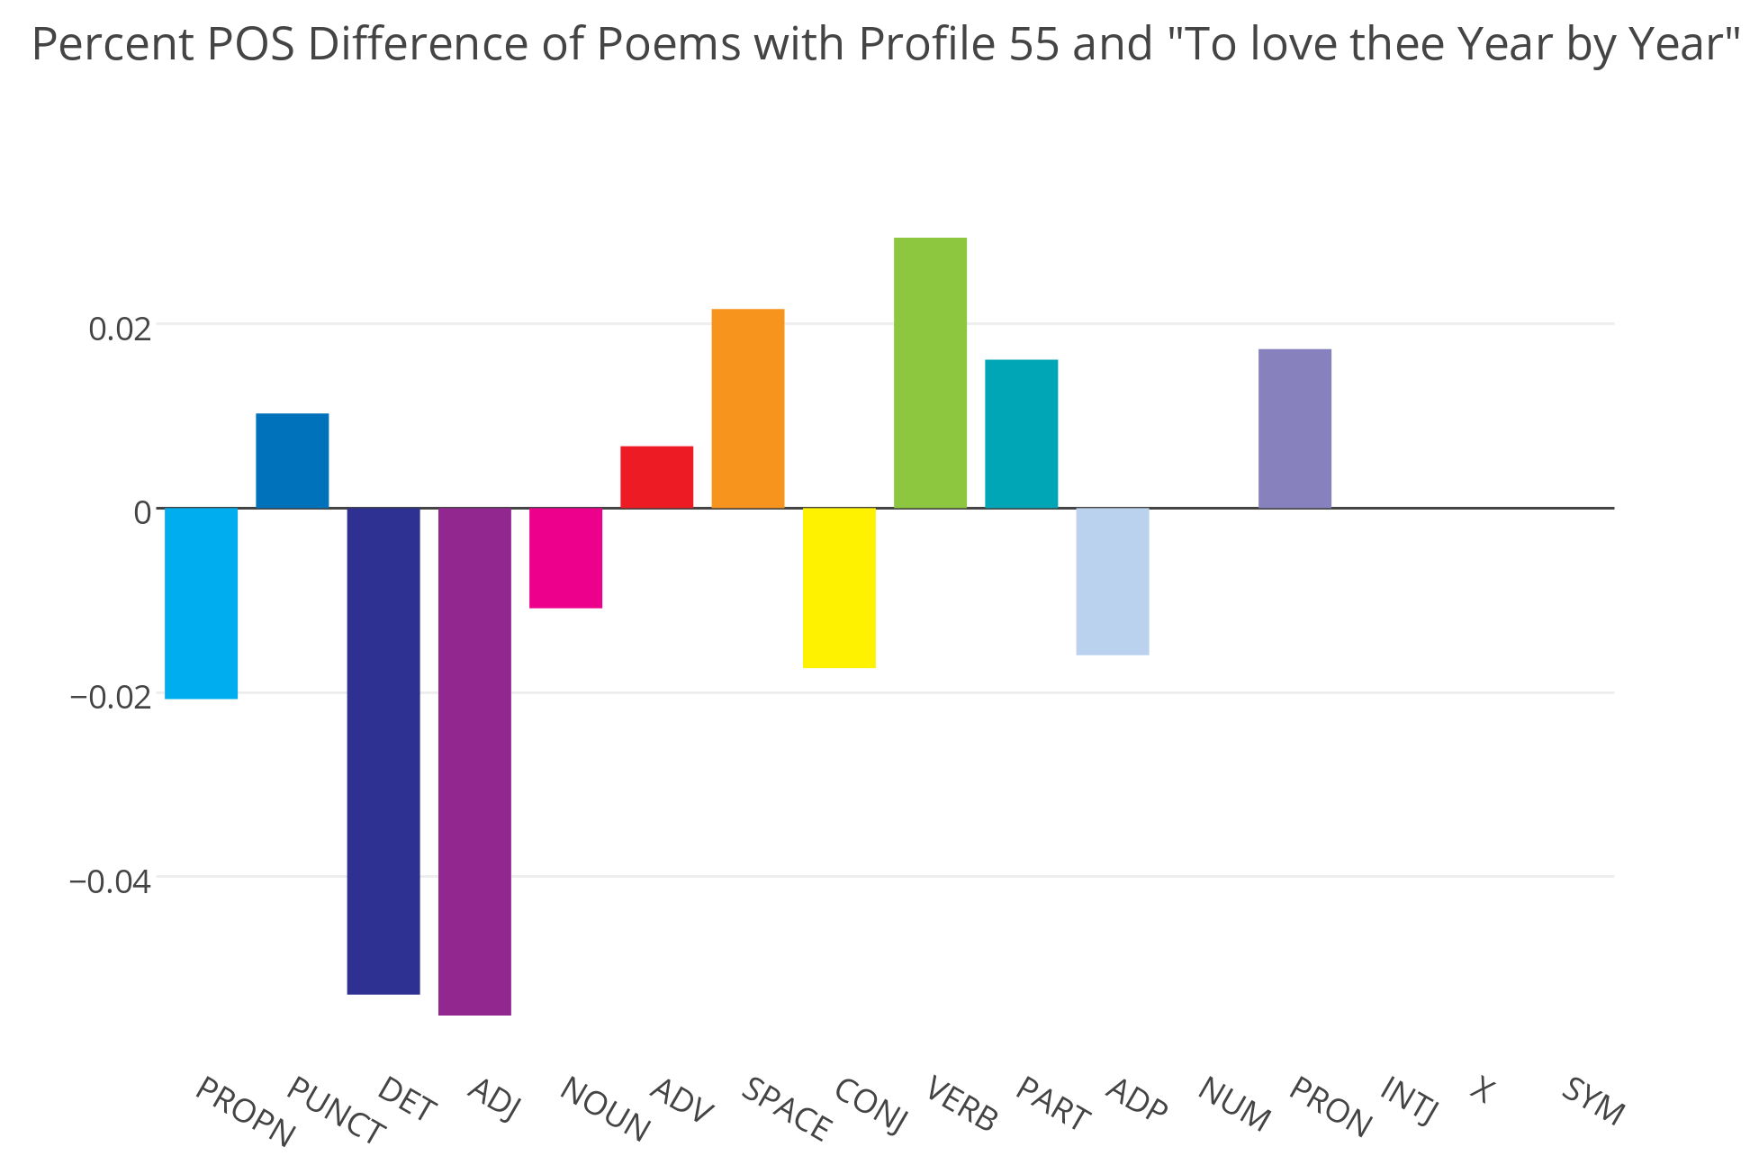
Approaching questions at multiple scales
Among Clusters: Comparing PMF Profile 55 to other PMF Profiles
Inside a Cluster: Comparing PMF Cluster 55 Poems to “To love thee Year by Year”

Slide 35
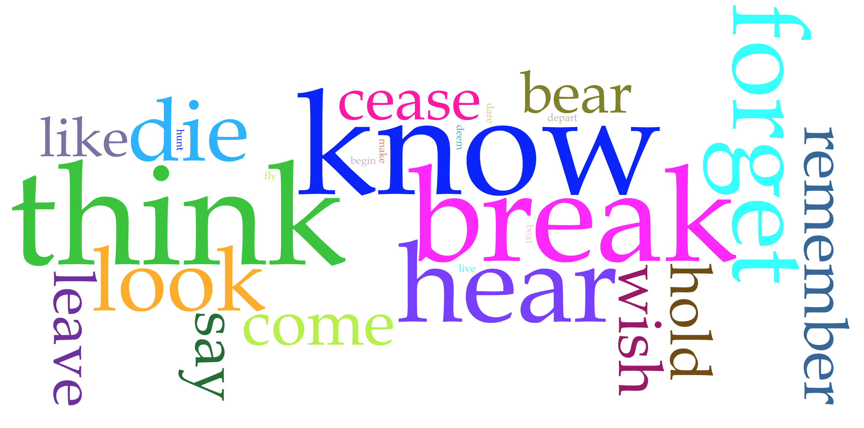
Some Semantic Notes
think (7), know (6), wish (3)
hear (5), look (4), hunt (2)
forget (5), remember (3)
die (4), cease (3), begin (2), live (2)
leave (3), come (3), depart (2), fly (2), dare (2)
bear (3), hold (3)
like (3)
say (3), make (2), deem (2), beat (2)
Top 25 Verbs of PMF-POS Profile 55
(sans forms of be, have, should, and could)

Slide 36
To love thee Year by Year — May less appear Than sacrifice, and cease — However, dear, Forever might be short, I thought to show — And so I pieced it, with a flower, now.
verbs shared by cluster 55
verbs unique to this poem
9th poem of Emily Dickinson’s 29th fascicle

Slide 37
–– references death
–– “about” death
–– “about” thought & death
Poem 9 of Fascicle 29: To love thee Year by Year PMF Part of Speech Cluster 55 Similar Poems: Poem 19 of Fascicle 1: "Oh if remembering were forgetting -” Poem 7 of Fascicle 2: "It did not surprise me” Poem 23 of Fascicle 3: "If I should die” Poem 1 of Fascicle 4: "Perhaps you'd like to buy a flower” Poem 13 of Fascicle 9: "I shall know why - when Time is over” Poem 27 of Fascicle 9: "I should not dare to leave my friend” Poem 8 of Fascicle 12: "I got so I could hear his name” Poem 5 of Fascicle 16: "I felt a Funeral, in my Brain” Poem 16 of Fascicle 19: "I cried at Pity - not at Pain” Poem 1 of Fascicle 21: "I Years had been from Home” Poem 18 of Fascicle 22: "I was the slightest in the House” Poem 8 of Fascicle 28: "The Winters are so short” Poem 10 of Fascicle 29: "Did you ever stand in a Cavern's Mouth” Poem 11 of Fascicle 38: "I play at Riches - to appease"

Slide 38
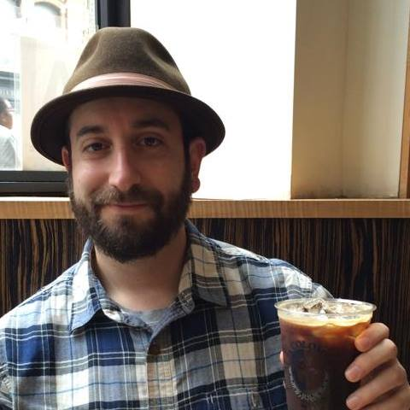


Thanks!
Programs
spaCy (NLP magic): spacy.io
Nimfa (Matrix factorization): nimfa.biolab.si
plotly (Graphs): plot.ly
Python (Sublime & Elbow grease): python.org
(Accessible) Recommended Reading
Koren et al. (2009) – “Matrix Factorization Techniques for Recommender Systems”
Lee and Seung (1999) – “Learning the parts of objects by non-negative matrix factorization”
: @jonathangrams
: github.com/jarmoza

